Slide 1
Science of Living System (BS20001)
SOUMYA DE
Office: Rm# 219, Life Sciences Building
Phone: 03222-284552
E-mail: somde@iitkgp.ac.in
Website: http://www.iitkgp.ac.in/department/BS/faculty/bs-somde
Research interests:
Biophysics
Nuclear Magnetic Resonance (NMR) Spectroscopy
Protein Engineering
Signal Transduction and Gene Expression
Enzymology

Slide 2
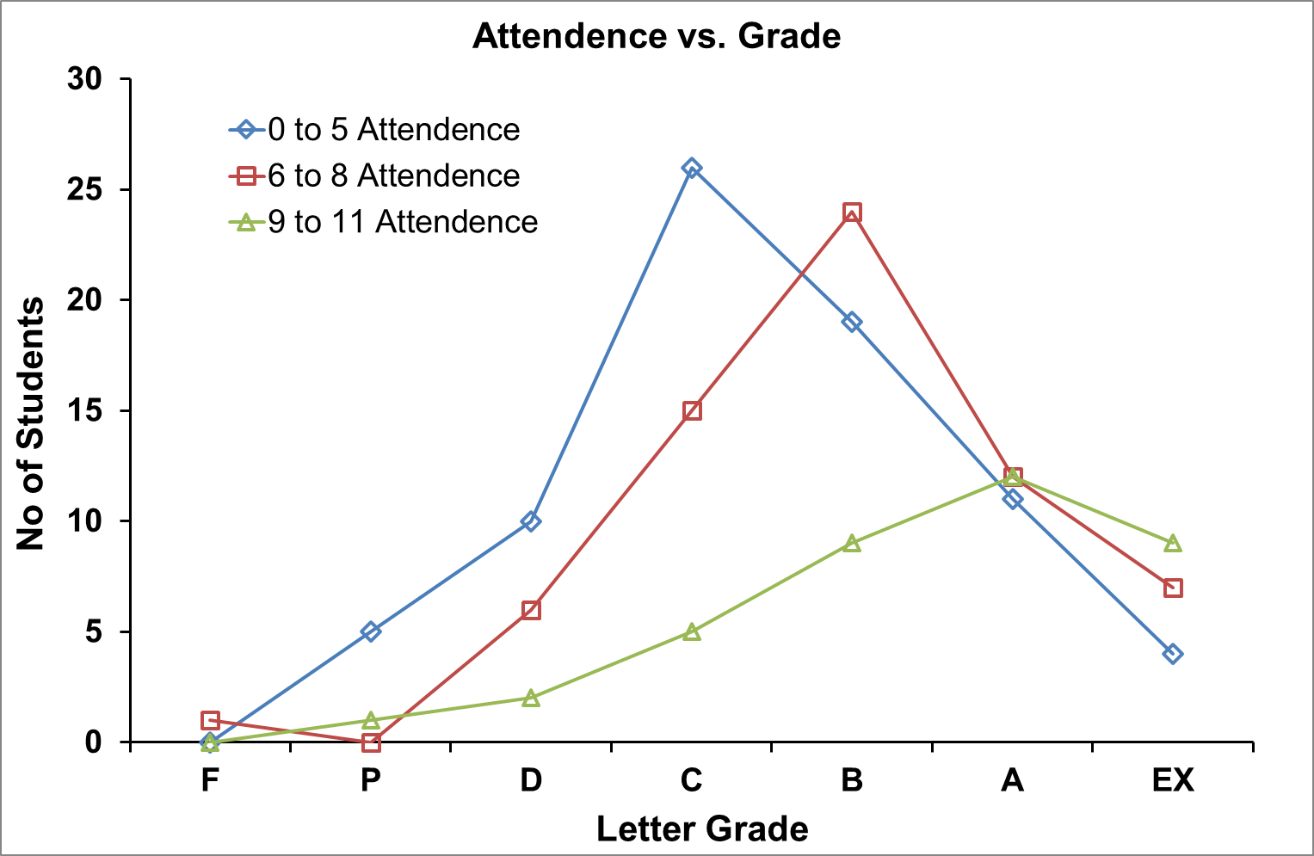

Slide 3
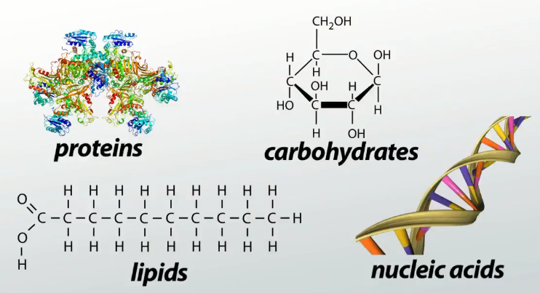
Molecules of Life Biological Macromolecules

Slide 4
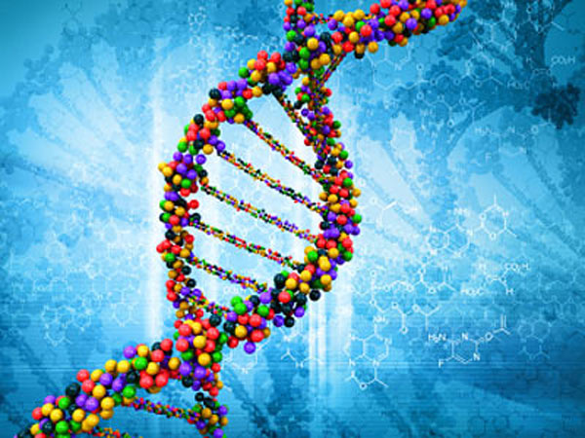
Nucleic Acid

Slide 5
Nucleic Acid
RNA: Ribonucleic Acid
DNA: Deoxyribonucleic Acid

Slide 6
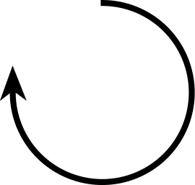
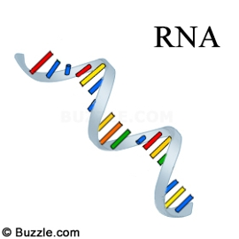
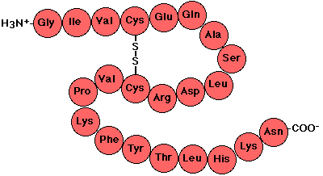
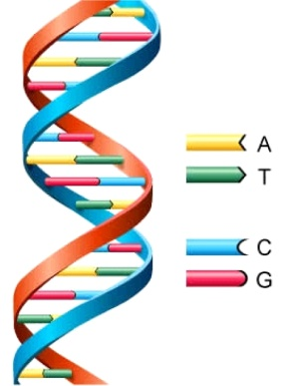
Flow of Genetic Information:
The Central Dogma of Molecular Biology
DNA Polymerase
RNA Polymerase
Ribosome
DNA
RNA
Protein
Transcription
Translation
Replication
DNA
RNA
Protein
Polymer of nucleotides
Polymer of nucleotides
Polymer of amino acids
Notes:
The central dogma of life was proposed by Francis Crick ca 1956. Here the arrows indicate the direction of transfer of genetic information. The circular arrow on DNA refers to the fact that DNA is the template for its self-replication. This is carried out by the enzyme DNA polymerase. DNA also serves as the template for RNA synthesis during transcription and this is catalyzed by the enzyme RNA polymerase. Finally, the information encoded on RNA (messenger RNA to be precise) is used to synthesize proteins by ribosomes. DNA, RNA and proteins are all polymers. The monomeric unit for DNA and RNA are called nucleotides whereas for proteins they are amino acids.

Slide 7

DNA is a long thread that stores information
DNA
RNA
Protein
Polymer of nucleotides
Polymer of nucleotides
Polymer of amino acids
Cassette Tape

Slide 8
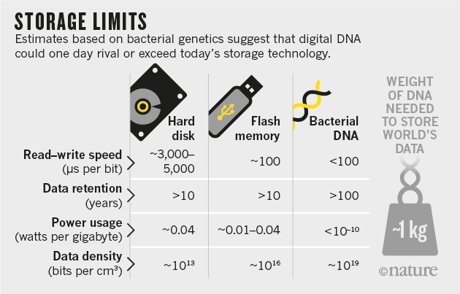
Why study Living System?
455 Exabyte/gm

Slide 9
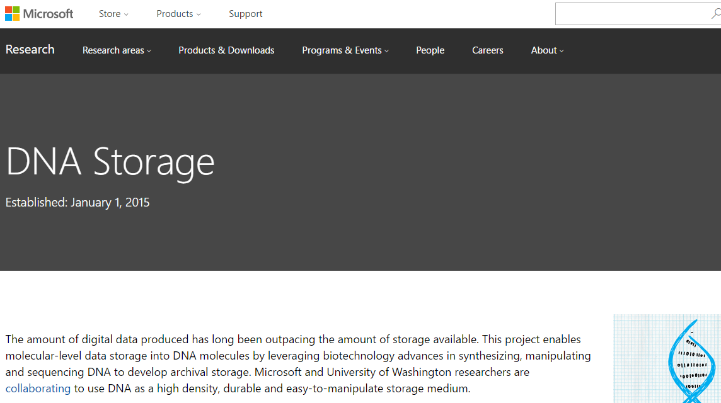
Microsoft Corporation – DNA Storage Research
A DNA-Based Archival Storage System Bornholt J, et. al. ASPLOS 2016 (International Conference on Architectural Support for Programming Languages and Operating Systems)
https://ieeexplore.ieee.org/document/7948677

Slide 10
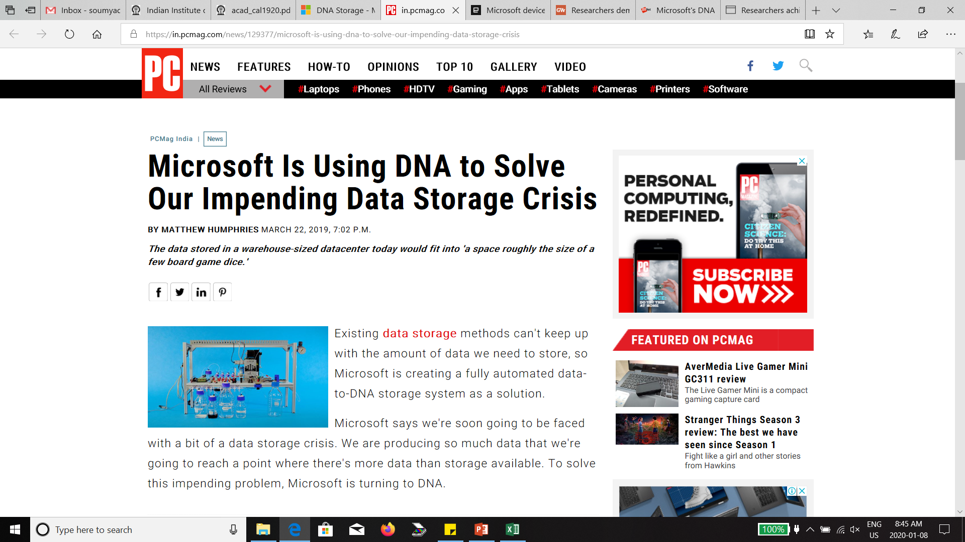
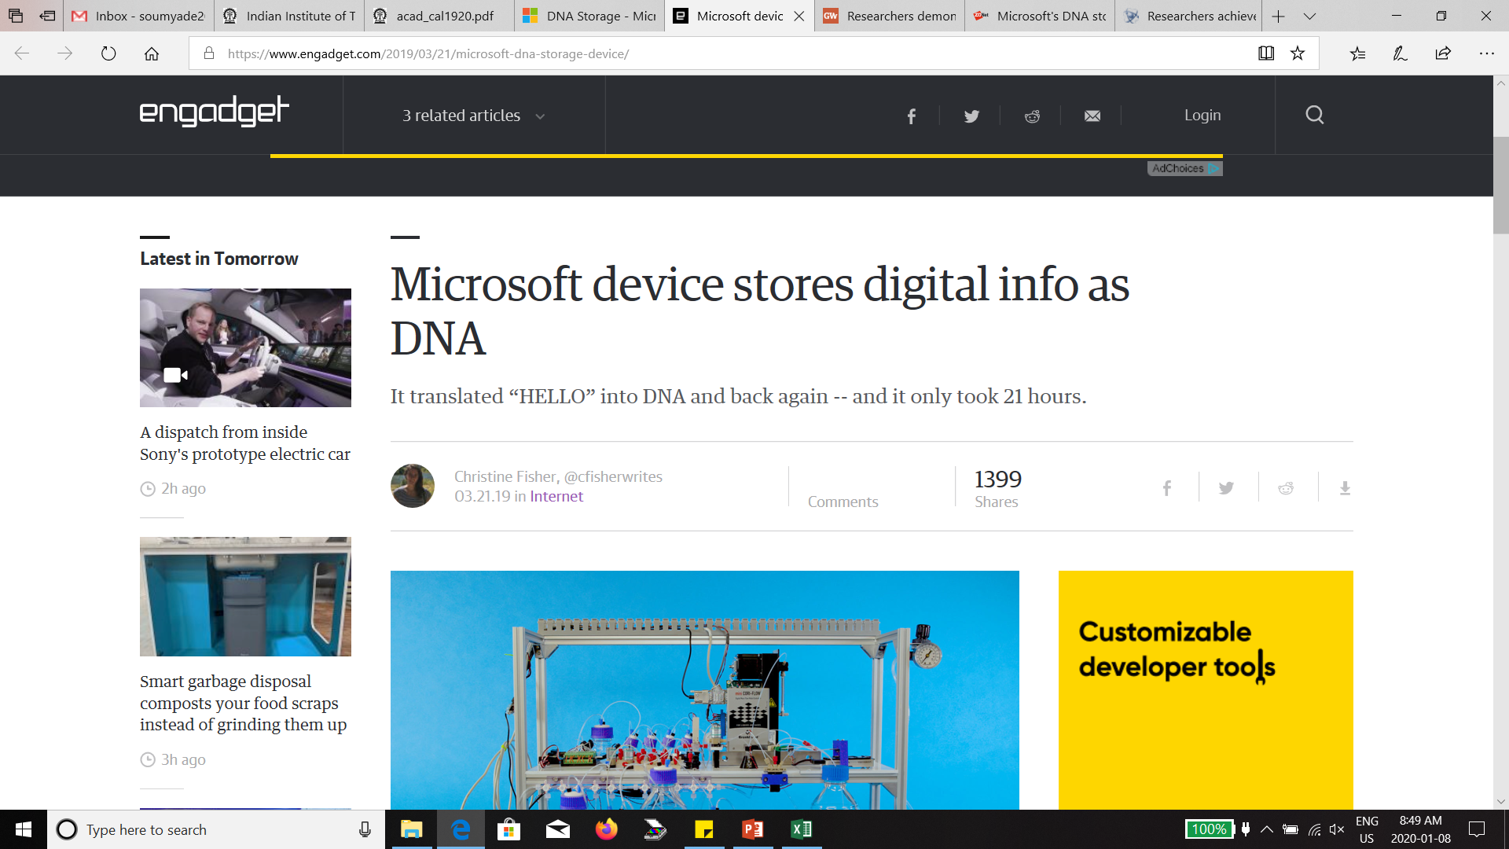
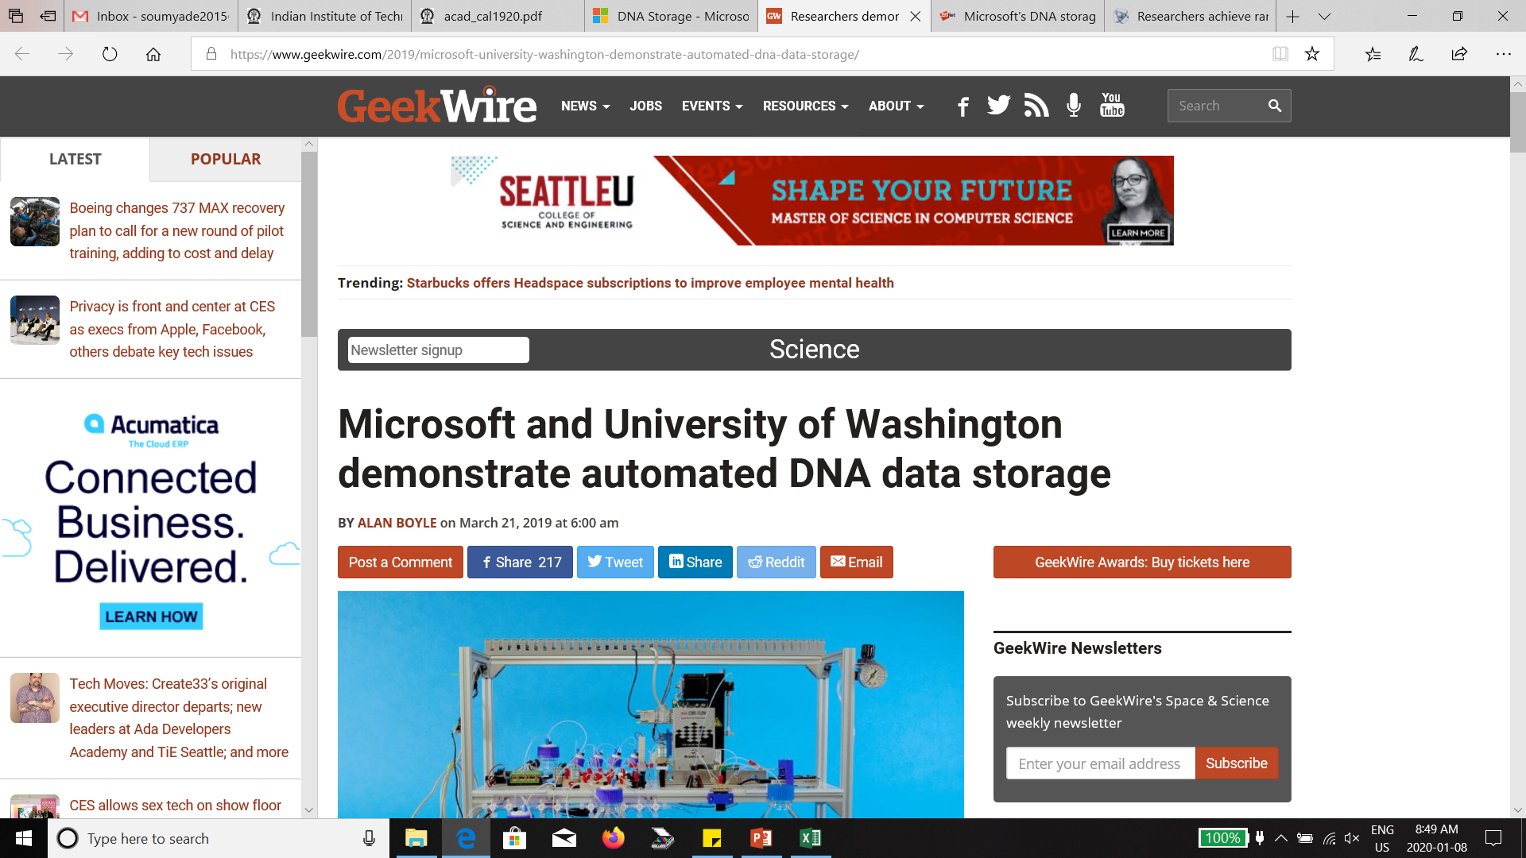
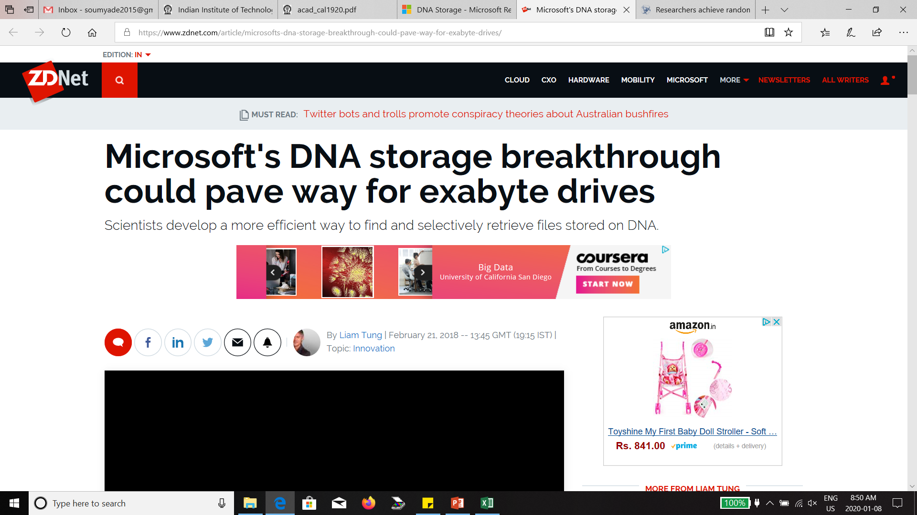

Slide 11
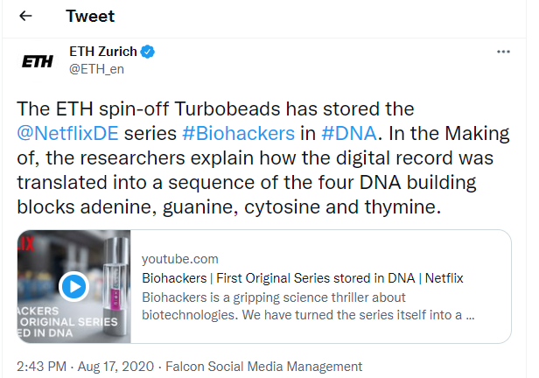
DNA Storage is robust and has high storage density

Slide 12
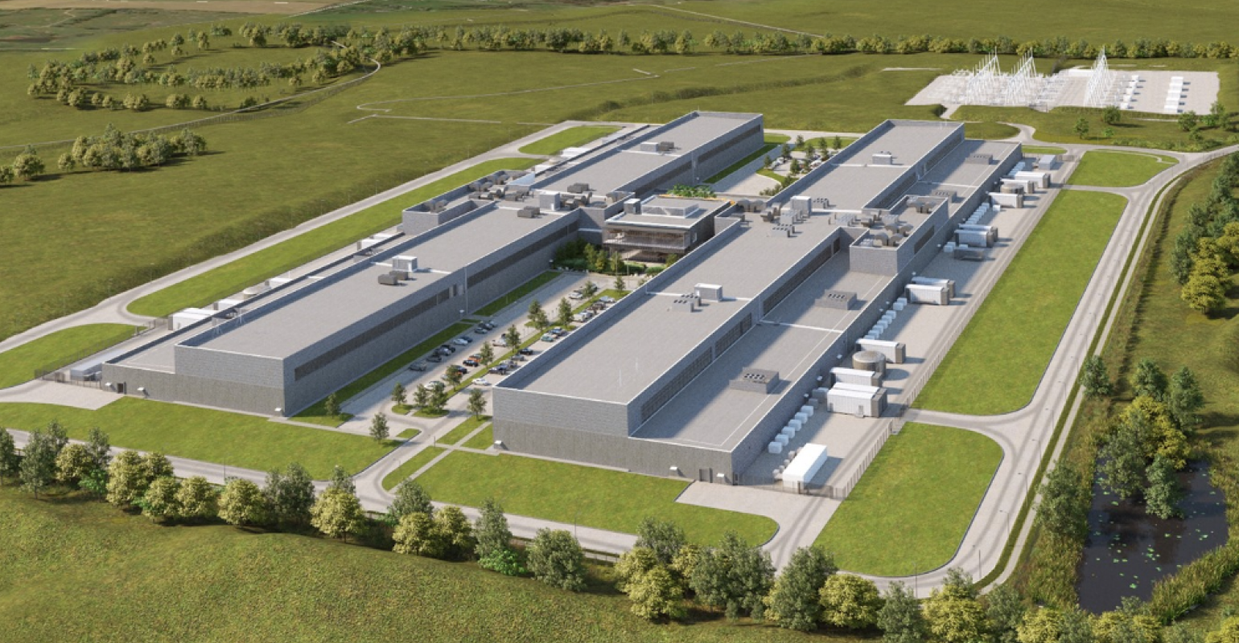
DNA Storage has high storage density
$800 million data center in Gallatin, a small town just outside of Nashville, Tennessee. Facebook acquired the 809 acres of land for this data center in 2020. One cricket ground is ~ 4 acres. Storage capacity is several Exabyte of data. 1 gm of DNA can store 455 Exabyte of data.

Slide 13
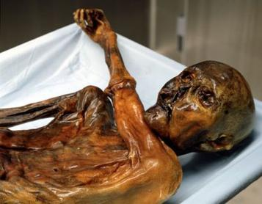
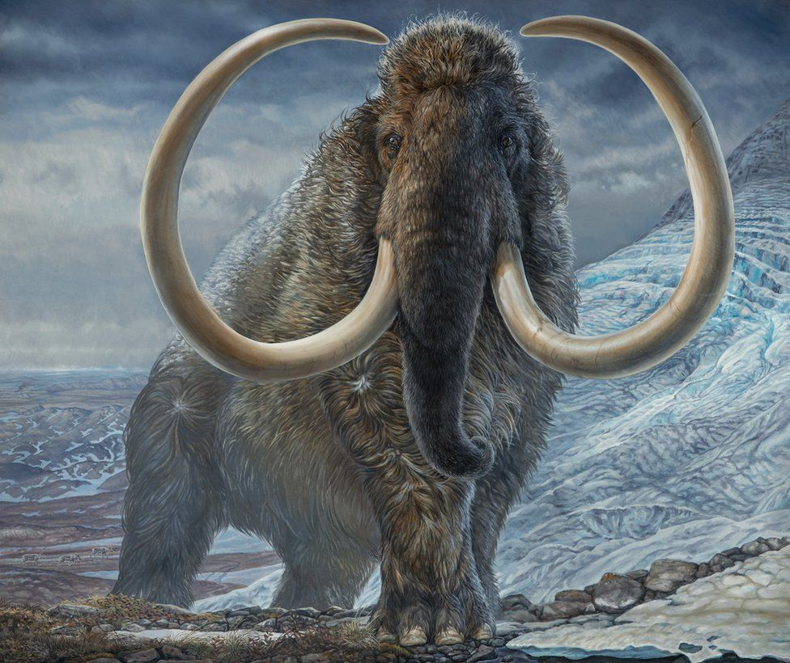
DNA Storage is robust
Otzi the mummy was discovered in 1991 in the Ötztal Alps on the border between Austria and Italy.
He lived from 3275 BC to 3230 BC i.e. 5000 years ago.
Otzi's full genome has been sequenced and published on February 2012.
DNA analysis also showed him at high risk of atherosclerosis and lactose intolerance.
DNA of over 3,700 Tyrolean male blood donors revealed that Otzi has living relatives in Austria today.
https://en.wikipedia.org/wiki/Otzi
Oldest DNA sequenced: DNA extracted from the tooth of 1.2 million year old mammoth. (Feb 2021) https://www.nature.com/articles/d41586-021-00436-x
In 2016, researchers reported protein sequences from 3.8-million-year-old ostrich eggshells from Tanzania.
https://www.bbc.com/news/science-environment-58191123

Slide 14
Nucleic Acid
Nucleic acids are polymers
Monomer---nucleotides
Nitrogenous bases
Purines
Pyrimidines
Sugar
Ribose
Deoxyribose
Phosphates
Nucleosides
Nucleotides
Notes:
Nucleic acids (DNA and RNA) are polymers. The monomeric units are called nucleotides, which have three components: nitrogenous bases, sugar and phosphate.

Slide 15
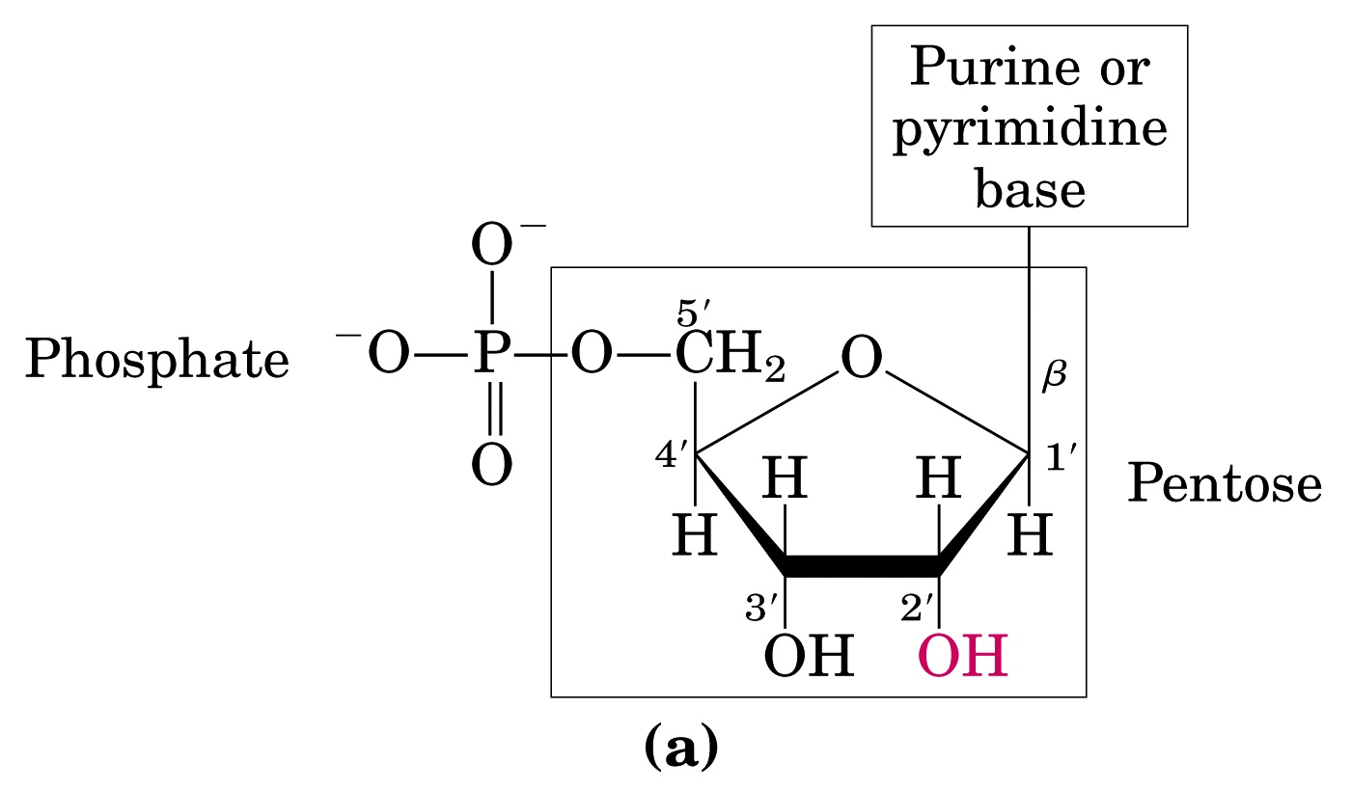
Nucleic Acid monomer structure
RNA - Ribonucleic Acid
DNA - Deoxyribonucleic Acid
(OH)
(H)
N-β-glycosyl bond
(Ribose)
Ester Bond
Notes:
The sugar has five carbons and has the common name Pentose. The numbering of the carbon atoms are shown (important!) and are followed by the symbol prime (‘) to distinguish them from the numbered atoms on the nitrogenous bases. Nucleic acids have two kinds of pentoses: ribose and deoxyribose. The difference occurs at the 2’ position that has OH group in ribose sugar and H in deoxyribose sugar. The nitrogenous base (purine or pyrimidine) is covalently linked to the pentose sugar at 1’ carbon and the phosphate group is linked by an ester bond at the 5’ carbon.

Slide 16
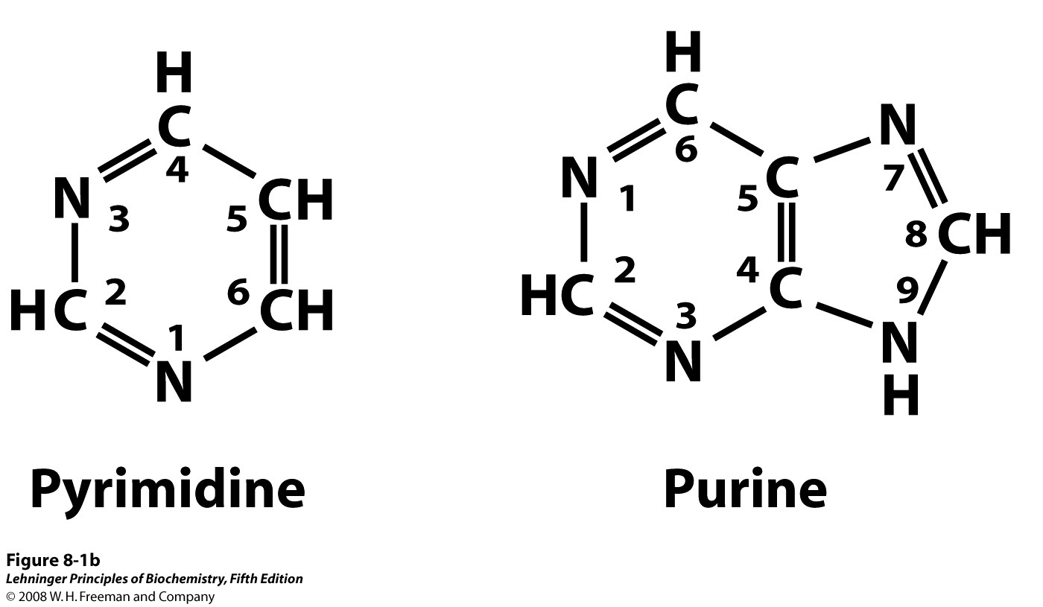
Two Types of Nitrogenous Bases
Notes:
The nitrogenous bases are of two types: purine and pyrimidine. The numbering conventions are shown. The N-1 of pyrimidine and N-9 of purine are covalently linked to the 1’ carbon of the pentose sugar in DNA and RNA.

Slide 17
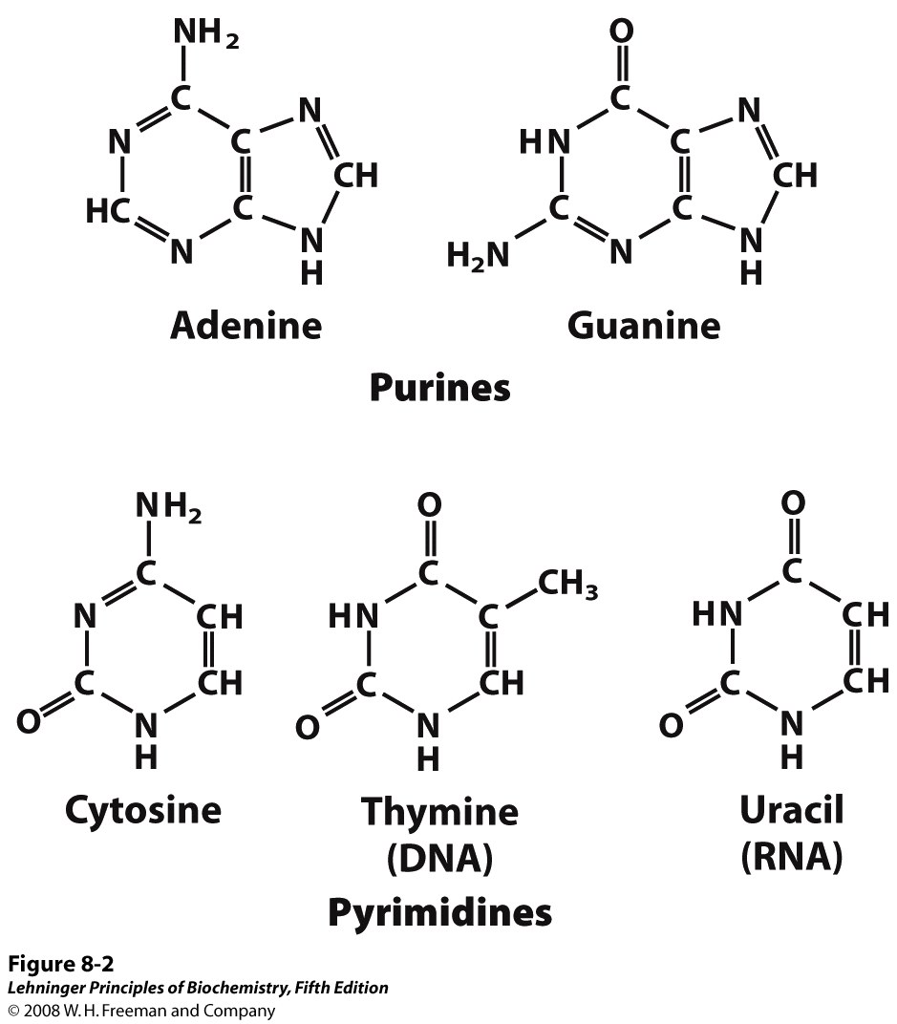
Purine and Pyrimidine Bases
Notes:
Major purine and pyrimidine bases. Adenine, guanine and cytosine are common to both DNA and RNA. It is important to note that Thymine is present in DNA whereas Uracil occurs in RNA.

Slide 18
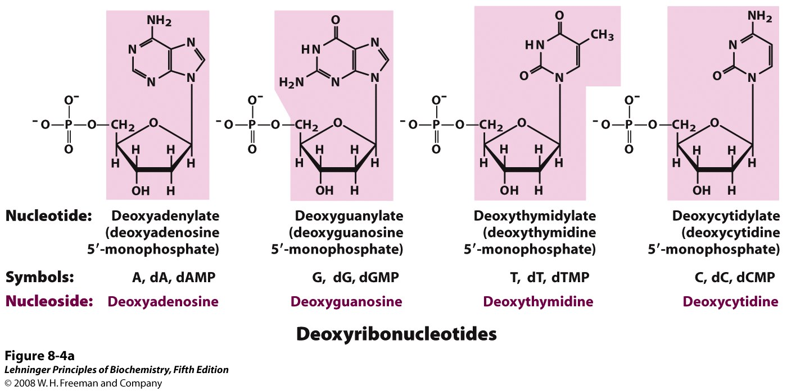
Nucleotide = Nucleoside + Phosphate
(Nucleoside = Sugar + Base)
Notes:
Deoxyribonucleotides and ribonucleotides of nucleic acids. All nucleotides are shown in their free form at pH 7.0. The nucleotide units of DNA (a) are usually symbolized as A, G, T, and C, sometimes as dA, dG, dT, and dC; those of RNA (b) as A, G, U, and C. In their free form the deoxyribonucleotides are commonly abbreviated dAMP, dGMP, dTMP, and dCMP; the ribonucleotides, AMP, GMP, UMP, and CMP. For each nucleotide, the more common name is followed by the complete name in parentheses. All abbreviations assume that the phosphate group is at the 5′ position. The nucleoside portion of each molecule is shaded in pink. In this and the following illustrations, the ring carbons are not shown.

Slide 19
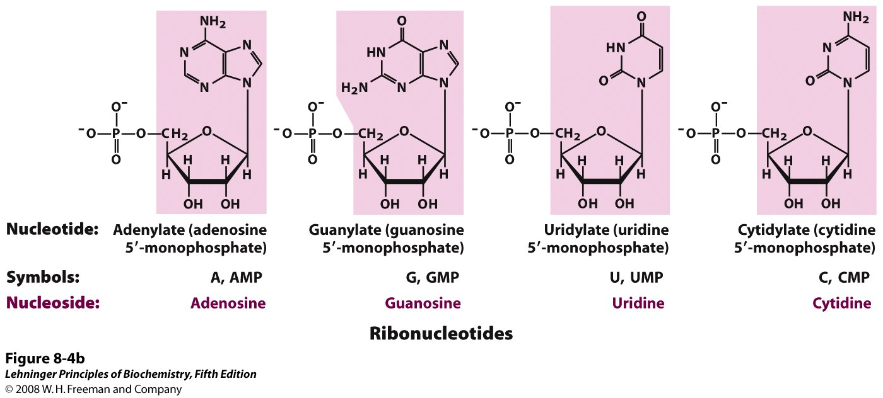
Nucleotide = Nucleoside + Phosphate
(Nucleoside = Sugar + Base)
Notes:
Deoxyribonucleotides and ribonucleotides of nucleic acids. All nucleotides are shown in their free form at pH 7.0. The nucleotide units of DNA (a) are usually symbolized as A, G, T, and C, sometimes as dA, dG, dT, and dC; those of RNA (b) as A, G, U, and C. In their free form the deoxyribonucleotides are commonly abbreviated dAMP, dGMP, dTMP, and dCMP; the ribonucleotides, AMP, GMP, UMP, and CMP. For each nucleotide, the more common name is followed by the complete name in parentheses. All abbreviations assume that the phosphate group is at the 5′ position. The nucleoside portion of each molecule is shaded in pink. In this and the following illustrations, the ring carbons are not shown.

Slide 20
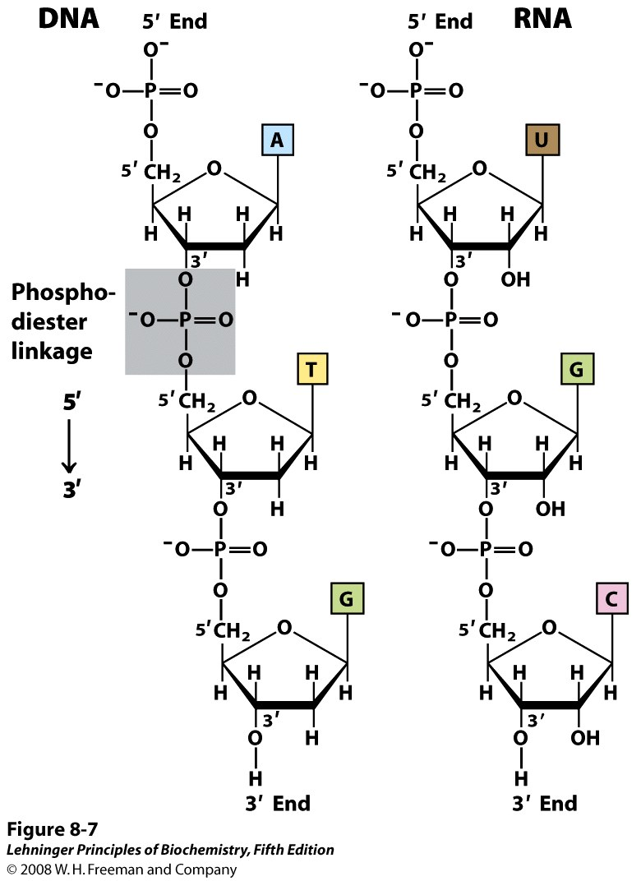
Phosphodiester Linkages in the Covalent Backbone of Nucleic Acid
Notes:
A single nucleotide chain contains a pentose-phosphate backbone. Individual pentose rings are connected through phospho-diester bonds. Each of these phospho-diester bonds connect the 3’- and 5’-OH groups. The chain has an end to end chemical orientation having 5’-phosphate at one terminal and 3’-OH at the other. Later in this class we will see that the DNA or RNA polymerase synthesizes the nucleic acid chains from 5’ to 3’ orientation. Hence the convention is to read the nucleic acid chain from 3’ to 5’ direction.

Slide 21
How information is stored in DNA or RNA?
5’-ATG-3’
5’-ATC-3’
5’-ATA-3’
5’-ATT-3’
5’-TTG-3’
5’-TTC-3’
5’-TTA-3’
5’-TTT-3’
5’-GTG-3’
5’-GTC-3’
5’-GTA-3’
5’-GTT-3’
5’-CTG-3’
5’-CTC-3’
5’-CTA-3’
5’-CTT-3’
5’-AGG-3’
5’-AGC-3’
5’-AGA-3’
5’-AGT-3’
5’-TGG-3’
5’-TGC-3’
5’-TGA-3’
5’-TGT-3’
5’-GGG-3’
5’-GGC-3’
5’-GGA-3’
5’-GGT-3’
5’-CGG-3’
5’-CGC-3’
5’-CGA-3’
5’-CGT-3’
5’-ACG-3’
5’-ACC-3’
5’-ACA-3’
5’-ACT-3’
5’-TCG-3’
5’-TCC-3’
5’-TCA-3’
5’-TCT-3’
5’-GCG-3’
5’-GCC-3’
5’-GCA-3’
5’-GCT-3’
5’-CCG-3’
5’-CCC-3’
5’-CCA-3’
5’-CCT-3’
5’-AAG-3’
5’-AAC-3’
5’-AAA-3’
5’-AAT-3’
5’-TAG-3’
5’-TAC-3’
5’-TAA-3’
5’-TAT-3’
5’-GAG-3’
5’-GAC-3’
5’-GAA-3’
5’-GAT-3’
5’-CAG-3’
5’-CAC-3’
5’-CAA-3’
5’-CAT-3’

Slide 22
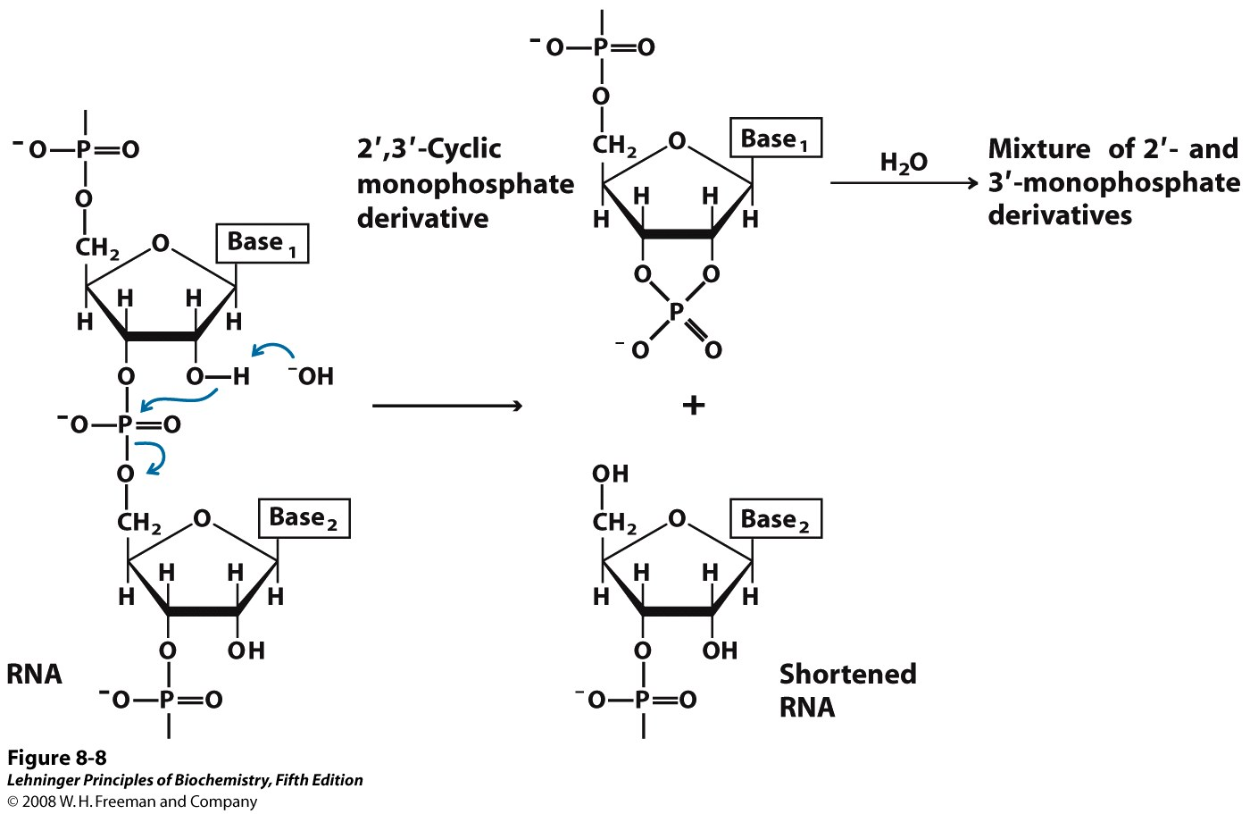
RNA is Less Stable than DNA
Notes:
Hydrolysis of RNA under alkaline conditions. The 2′ hydroxyl acts as a nucleophile in an intramolecular displacement. The 2′,3′-cyclic monophosphate derivative is further hydrolyzed to a mixture of 2′- and 3′-monophosphates. DNA, which lacks 2′ hydroxyls, is stable under similar conditions.
The more stable DNA is used to store genetic information whereas the less stable RNA is used as and intermediate copy for protein synthesis (See Central Dogma).

Slide 23
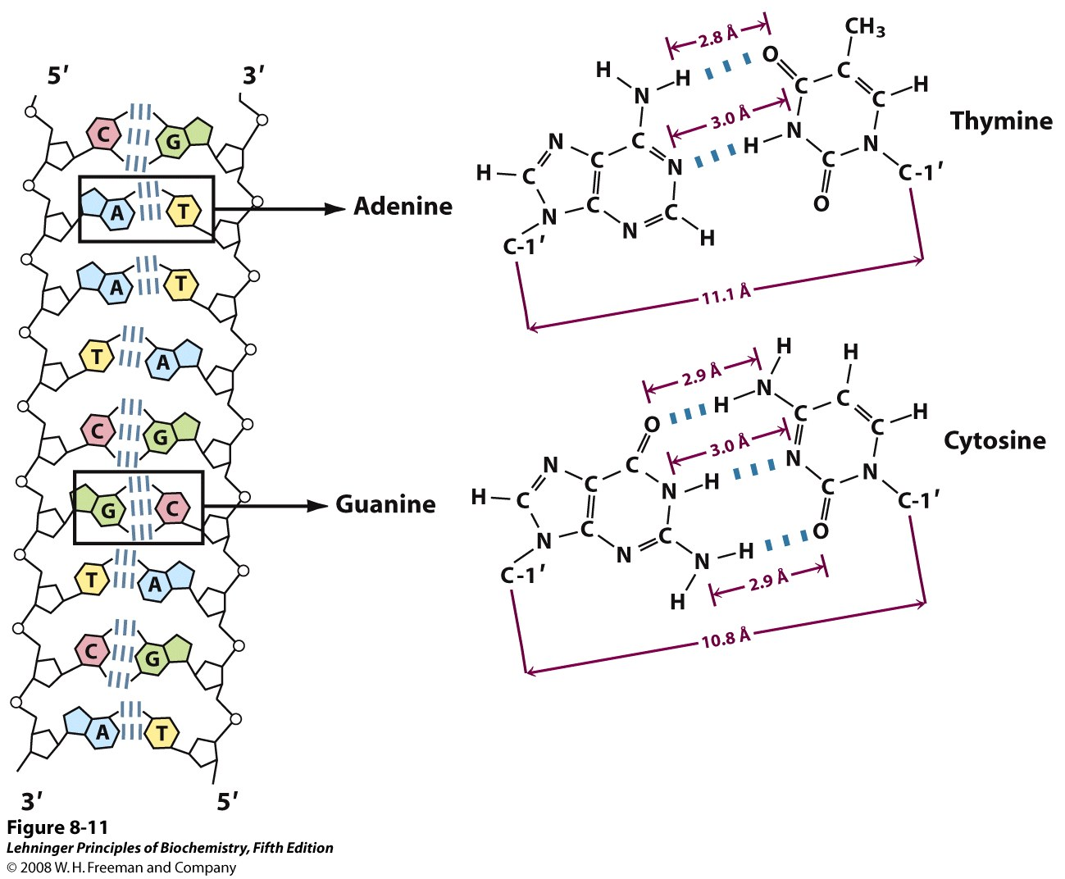
DNA: Deoxyribonucleic Acid
Complementary Strands
Notes:
In case of DNA two nucleic acid strands anneal together through extensive inter-strand H-bonding between the bases. This base pairing follows the rule proposed by Watson and Crick. A always pairs with T and G with C (Chargaff’s rule). Hence the two strands become complementary to each other. Directionality of two strands is opposite: one is 5’-3’ and another is 3’-5’. Hence complementary DNA strands are antiparallel. The base-paired antiparallel strands differ in base composition: the left strand has the composition A₃ T₂ G₁ C₃; the right, A₂ T₃ G₃ C₁.

Slide 24
Some key features of DNA
In DNA, two nucleic acid strands anneal together through extensive inter-strand H-bonding between the bases. This base pairing follows the rule proposed by Watson and Crick.
Chargaff’s rule: A always pairs with T and G pairs with C
Hence the two strands become complementary to each other
Directionality of two strands is opposite: one is 5’-3’ and another is 3’-5’
Hence complementary DNA strands are antiparallel

Slide 25
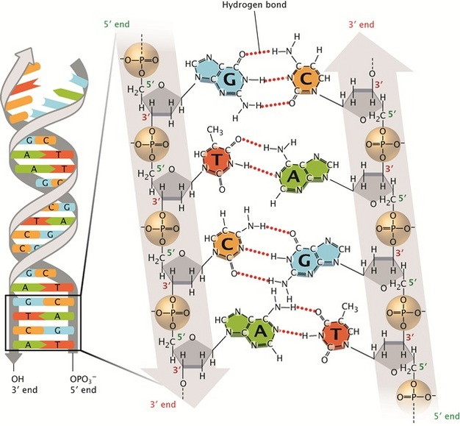
DNA: Deoxyribonucleic Acid
© 2013 Nature Education All rights reserved.

Slide 26
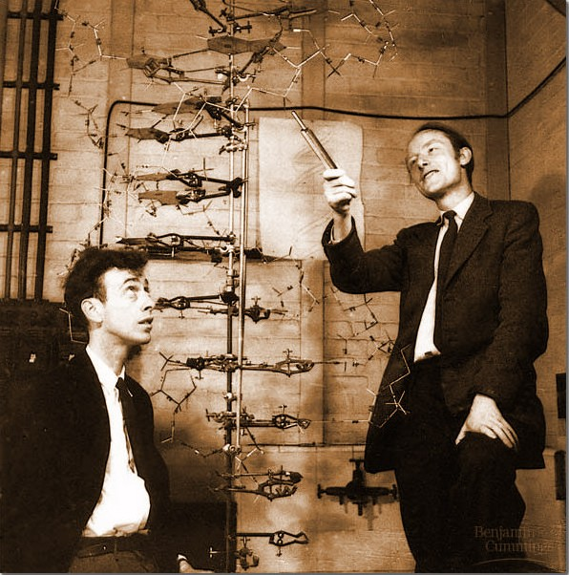
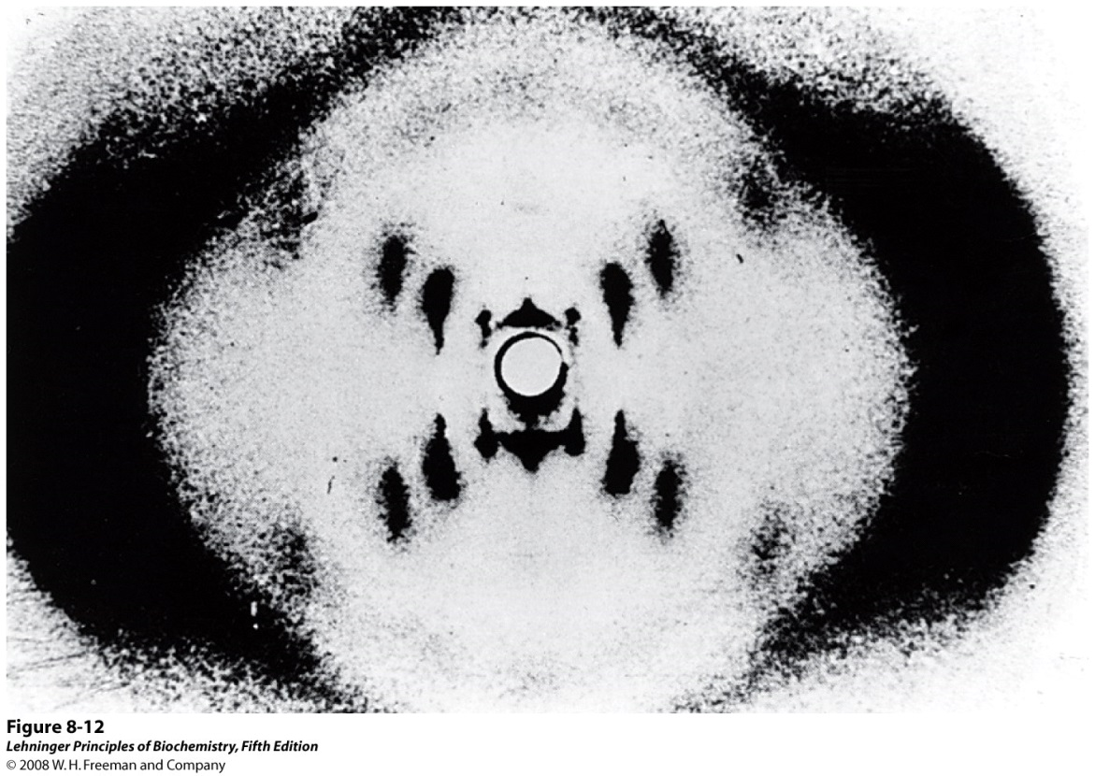
Discovery of the DNA Structure
Structure was discovered in 1953 by James Watson and Francis Crick
Awarded Nobel Prize in 1962
Rosalind Franklin
Notes:
DNA structure was discovered in 1953 by James Watson and Francis Crick based upon the x-ray diffraction data obtained by Rosalind Franklin and Maurice Wilkins. They proposed a double helix structure for double stranded DNA with A always hydrogen bonded to T and G with C.

Slide 27
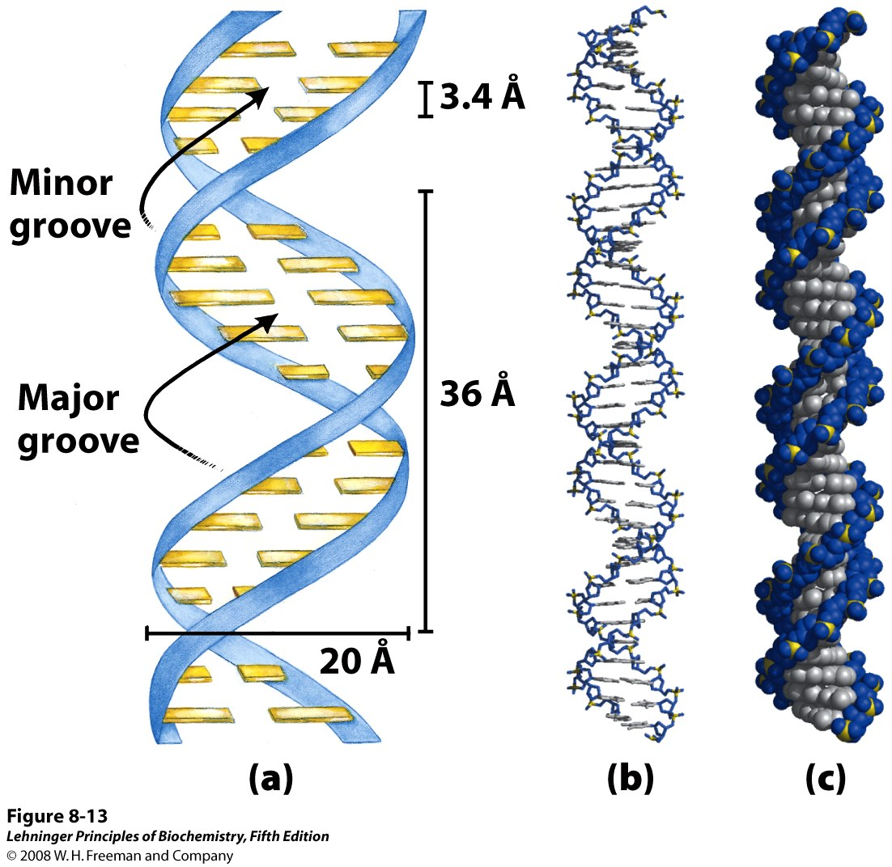
Watson-Crick Model for the Structure of DNA
a
b
c
Notes:
Watson-Crick model for the structure of DNA. In this structure, the pentose phosphate backbone of the DNA strands, which is significantly polar in nature remains outside and the bases which are hydrophobic pointed towards inside. The bases of the anti-parallel strands participates in H-bonding with each other. The original model proposed by Watson and Crick had 10 base pairs, or 34 Å (3.4 nm), per turn of the helix; subsequent measurements revealed 10.5 base pairs, or 36 Å (3.6 nm), per turn. (a) Schematic representation, showing dimensions of the helix. (b) Stick representation showing the backbone and stacking of the bases. (c) Space-filling model.
The spaces in between the interwind strands forms two helical grooves of different width as major and minor grooves. The bases are accessible to outside molecules, like water or DNA binding proteins and forms two different kinds of binding surfaces for them.

Slide 28
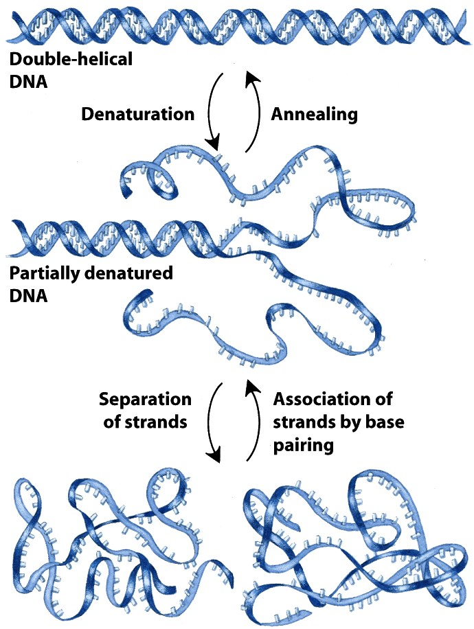
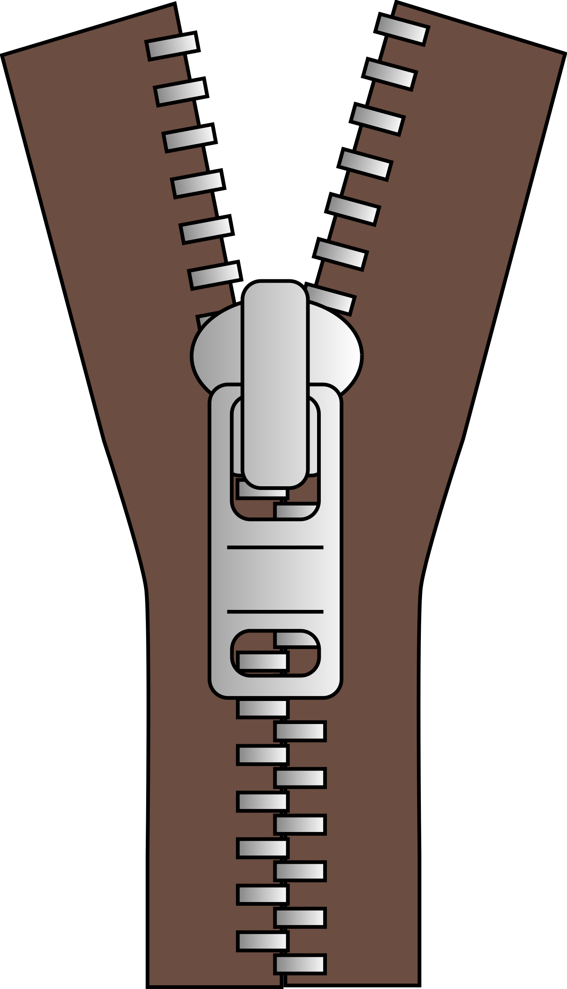
Reversible Denaturation and Annealing (Renaturation) of DNA
Notes:
Reversible denaturation and annealing (renaturation) of DNA.
Upon denaturation, the hydrophobic bases gets exposed to outside solvent hence becomes insoluble and precipitated out. That’s why if you denature DNA using heat or other chemical reagents it forms insoluble matter.
Double stranded DNA helix is the energetically favourable structure. That’s why, it takes energy to denature the DNA. Entropy decreases. Free energy increases. Non-spontaneous process.

Slide 29
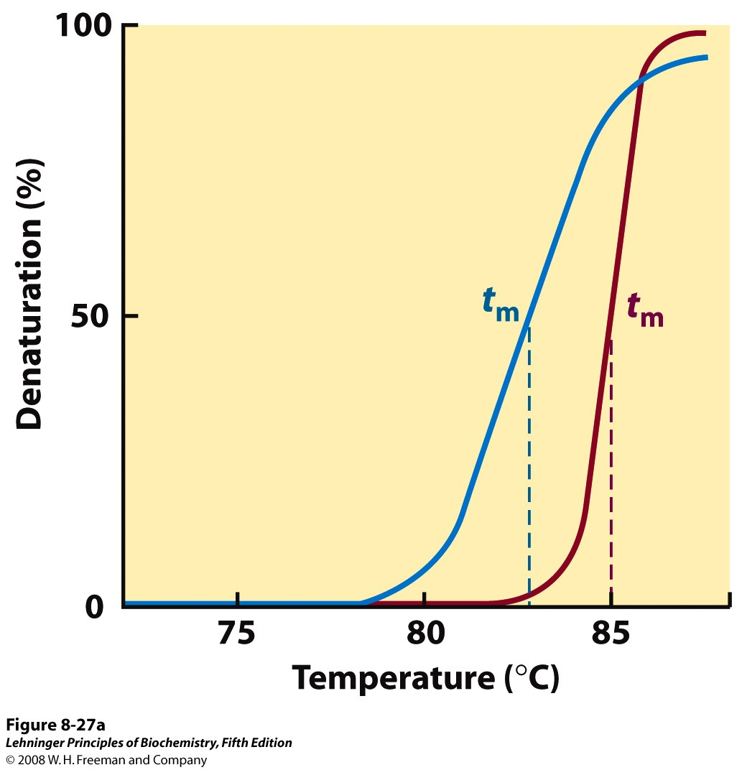
Heat Denaturation of DNA
Notes:
Heat denaturation of DNA. (a) The denaturation, or melting, curves of two DNA specimens. The temperature at the midpoint of the transition (t_{m}) is the melting point; it depends on pH and ionic strength and on the size and base composition of the DNA.
G-C base pair has three hydrogen bonds while A-T base pair has two hydrogen bonds. Hence, DNA sequences with higher G-C content are relatively tightly held together and have higher melting point.

Slide 30
Flow of Genetic Information:
The Central Dogma of Molecular Biology
DNA Polymerase
RNA Polymerase
Ribosome
DNA
RNA
Protein
Transcription
Translation
Replication
DNA
RNA
Protein
Polymer of nucleotides
Polymer of nucleotides
Polymer of amino acids
Notes:
The central dogma of life was proposed by Francis Crick ca 1956. Here the arrows indicate the direction of transfer of genetic information. The circular arrow on DNA refers to the fact that DNA is the template for its self-replication. This is carried out by the enzyme DNA polymerase. DNA also serves as the template for RNA synthesis during transcription and this is catalyzed by the enzyme RNA polymerase. Finally, the information encoded on RNA (messenger RNA to be precise) is used to synthesize proteins by ribosomes. DNA, RNA and proteins are all polymers. The monomeric unit for DNA and RNA are called nucleotides whereas for proteins they are amino acids.

Slide 31
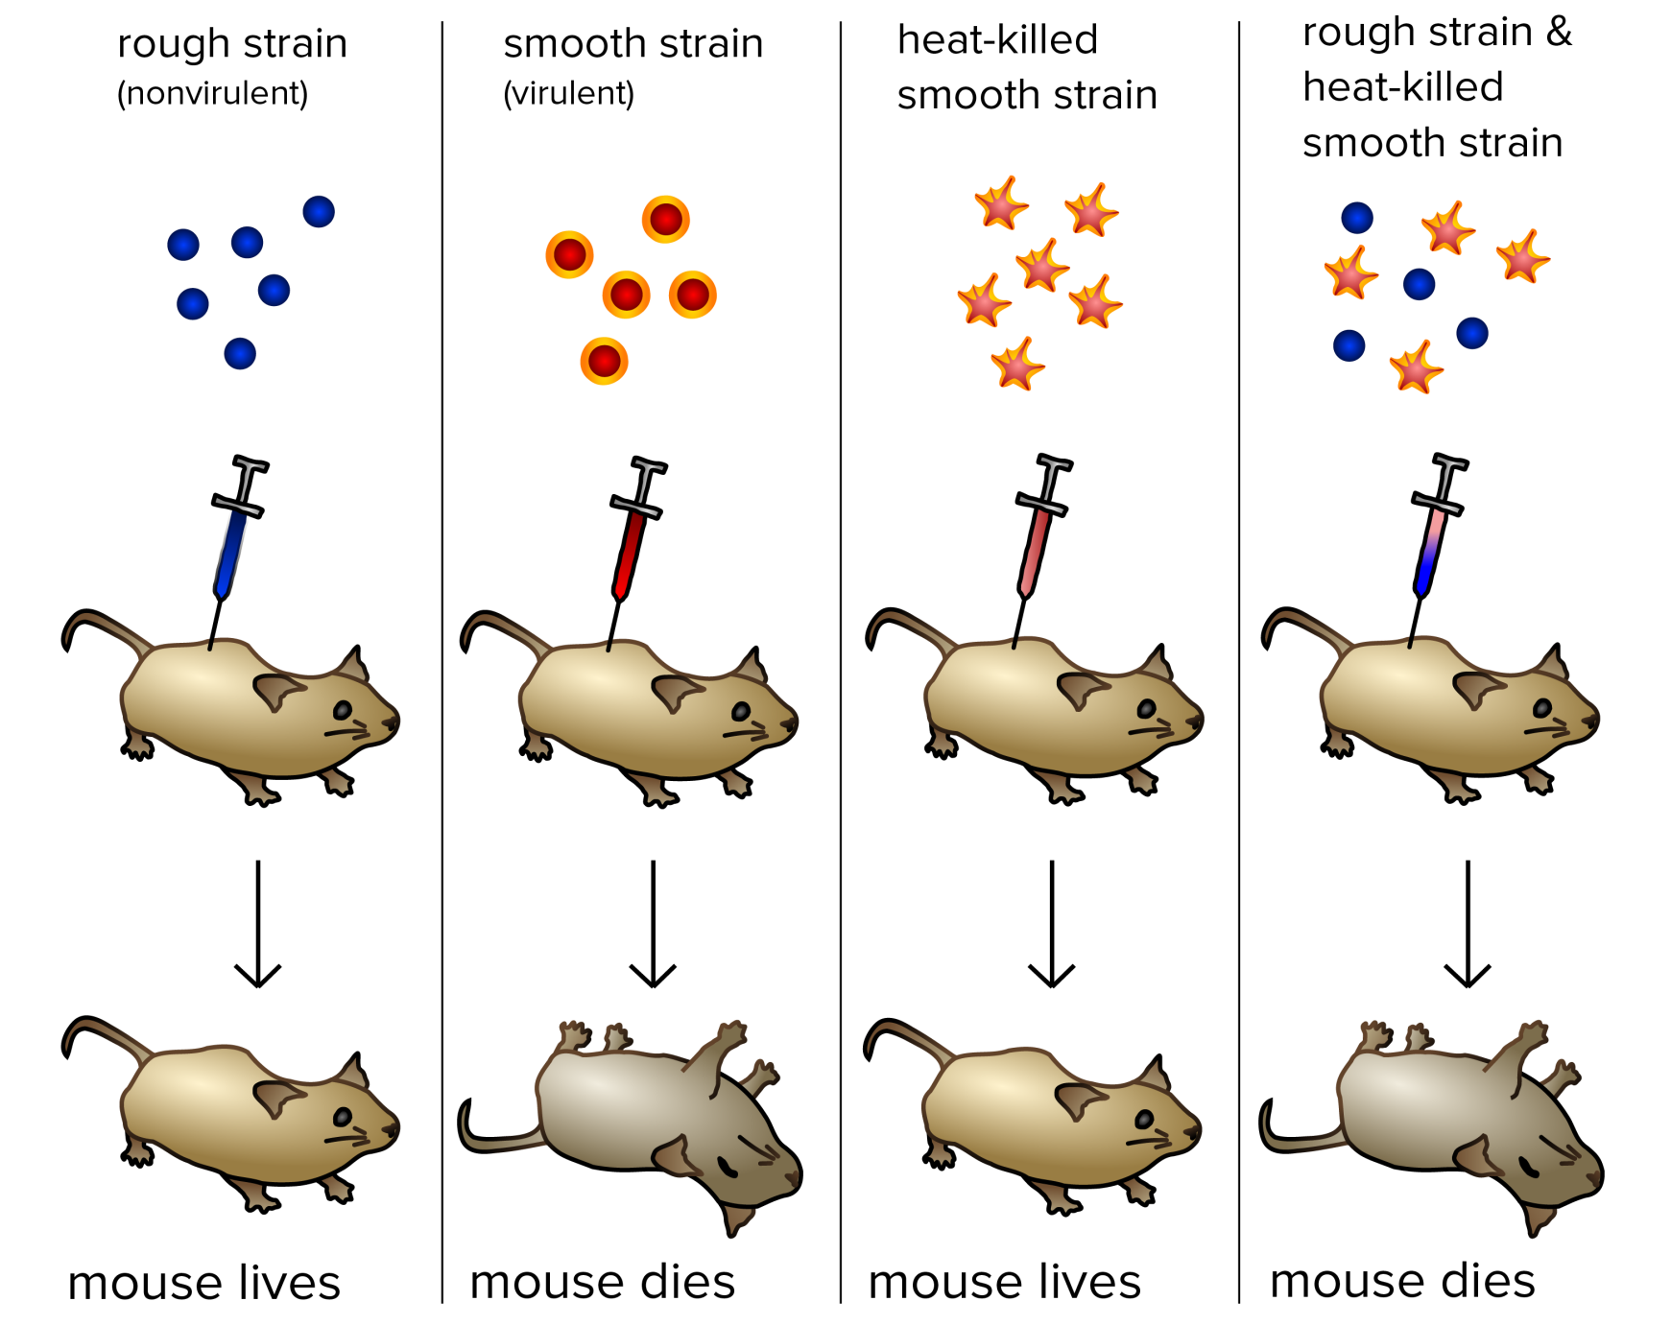
Experiment that Proves DNA is Our Genetic Material
Frederick Griffith’s experiment with bacteria (Streptococcus pneumoniae) (1928).
Notes:
Griffith's experiment, reported in 1928 by Frederick Griffith. Griffith's findings were followed by research in the late 1930s and early 40s that isolated DNA as the material that communicated this genetic information.
Frederick Griffith was a British bacteriologist whose focus was the epidemiology and pathology of bacterial pneumonia. Pneumonia was a serious cause of death in the wake of the post-WWI Spanish influenza pandemic, and Griffith was studying the possibility of creating a vaccine.
This discovery was followed by the famous Avery, MacLeod and McCarty’s 1944 experiment to show that genetic material is DNA. They digested transforming extract with DNase to show loss of transforming ability. And when they just purified DNA from the extract, that successfully transformed non-virulent bacteria into virulent form.

Slide 32
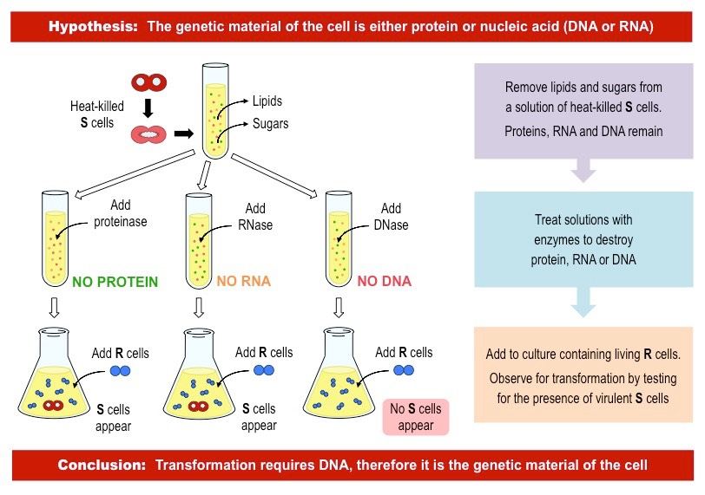
Experiment that Proves DNA is Our Genetic Material

Slide 33
Flow of Genetic Information:
The Central Dogma of Molecular Biology
DNA Polymerase
RNA Polymerase
Ribosome
DNA
RNA
Protein
Transcription
Translation
Replication
DNA
RNA
Protein
Polymer of nucleotides
Polymer of nucleotides
Polymer of amino acids
Notes:
The central dogma of life was proposed by Francis Crick ca 1956. Here the arrows indicate the direction of transfer of genetic information. The circular arrow on DNA refers to the fact that DNA is the template for its self-replication. This is carried out by the enzyme DNA polymerase. DNA also serves as the template for RNA synthesis during transcription and this is catalyzed by the enzyme RNA polymerase. Finally, the information encoded on RNA (messenger RNA to be precise) is used to synthesize proteins by ribosomes. DNA, RNA and proteins are all polymers. The monomeric unit for DNA and RNA are called nucleotides whereas for proteins they are amino acids.

Slide 34
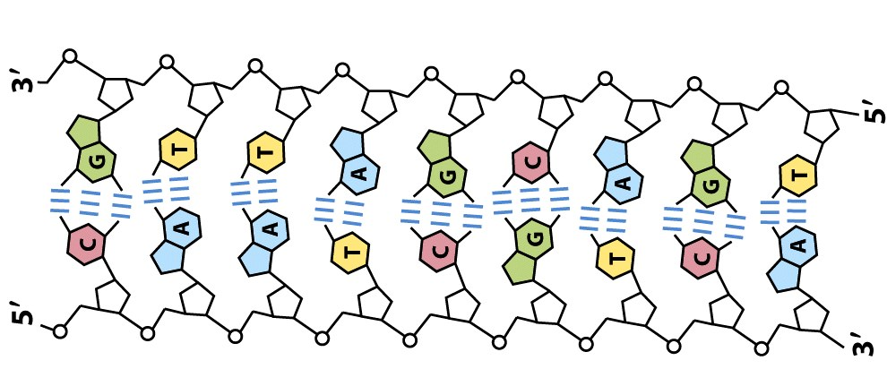
DNA Replication: An Overview
(Copying of the genetic information)

Slide 35
5’
3’
5’
3’
3’
5’
3’
5’
5’
3’
5’
3’
5’
3’
5’
3’
3’
5’
3’
5’
3’
5’
3’
5’
Conservative Replication
Semi-conservative Replication

Slide 36
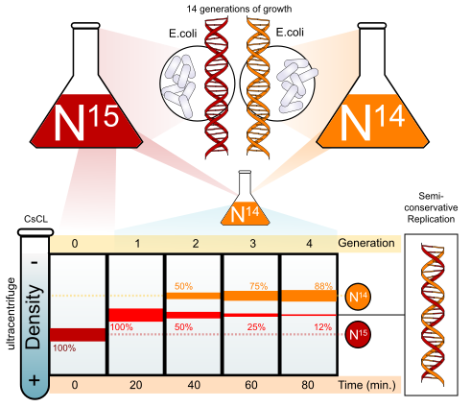
The Meselson-Stahl Experiment (1958)
Notes:
Semiconservative replication means that the daughter DNA has one newly synthesized strand and one old strand that served as the template.

Slide 37
Centrifugation with density gradient
ω
DNA with HIGHER density will move to the RIGHT i.e. BOTTOM of the tube.
DNA with LOWER density will stay at the LEFT i.e. TOP of the tube.
F_{B}
F_{C}
Density gradient

Slide 38
Harvest bacteria (40 min)
Extract DNA
Generation 2
Harvest bacteria (60 min)
Extract DNA
Generation 3
Harvest bacteria (80 min)
Extract DNA
Generation 4
Harvest bacteria
Harvest bacteria (20 min)
Extract DNA
Extract DNA
Generation 0
Generation 1

Slide 39
The Meselson-Stahl Experiment (1958)
Notes:
Semiconservative replication means that the daughter DNA has one newly synthesized strand and one old strand that served as the template.

Slide 40
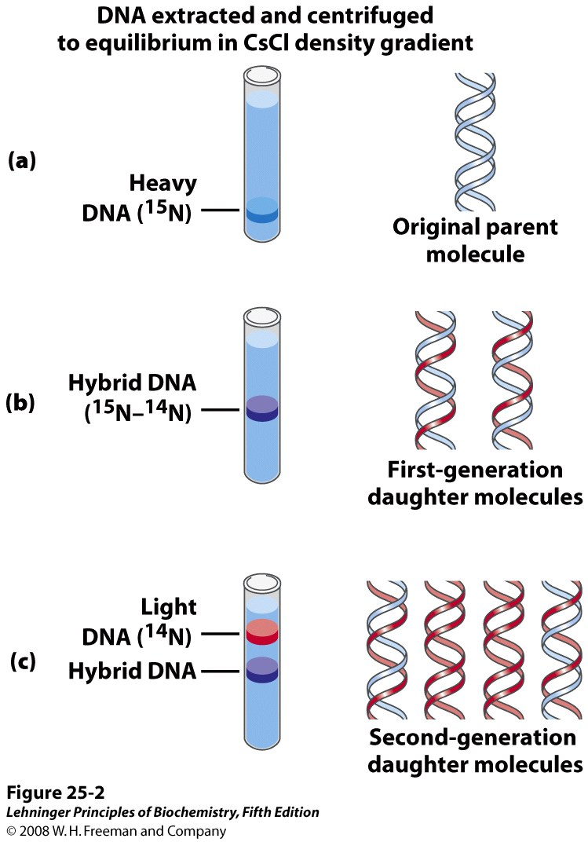
The Meselson-Stahl Experiment Supports Semiconservative Replication
Notes:
The Meselson-Stahl experiment. (a) Cells were grown for many generations in a medium containing only heavy nitrogen, ¹⁵N, so that all the nitrogen in their DNA was ¹⁵N, as shown by a single band (blue) when centrifuged in a CsCl density gradient. (b) Once the cells had been transferred to a medium containing only light nitrogen, ¹⁴N, cellular DNA isolated after one generation equilibrated at a higher position in the density gradient (purple band). (c) A second cycle of replication yielded a hybrid DNA band (purple) and another band (red), containing only [¹⁴N]DNA, confirming semiconservative replication.

Slide 41
Meselson and Stahl grew a culture of E.coli for many generations in a medium that contained ¹⁵N as the sole nitrogen source. (¹⁵NH4Cl).
After many generations, all the E.coli cells had ¹⁵N incorporated into the purine and pyrimidine bases of their DNA.
Meselson and Stahl took a sample of these bacteria and switched the rest of the bacteria to a medium that contained only ¹⁴N (washed them before transferring to remove the medium containing ¹⁵N).
They purified the DNA sample collected from the bacteria just before transfer to the ¹⁴N containing medium.
Meselson and Stahl collected some of the bacteria after each division and extracted DNA from the bacterial cells (Collected samples of bacteria over the next few cellular generations).
Under the conditions they used, E.coli replicates its DNA every 20 minutes. They took samples at an interval of 20 minutes.
After extracting DNA from bacteria they checked for the density of DNA

Slide 42
